Slide 1
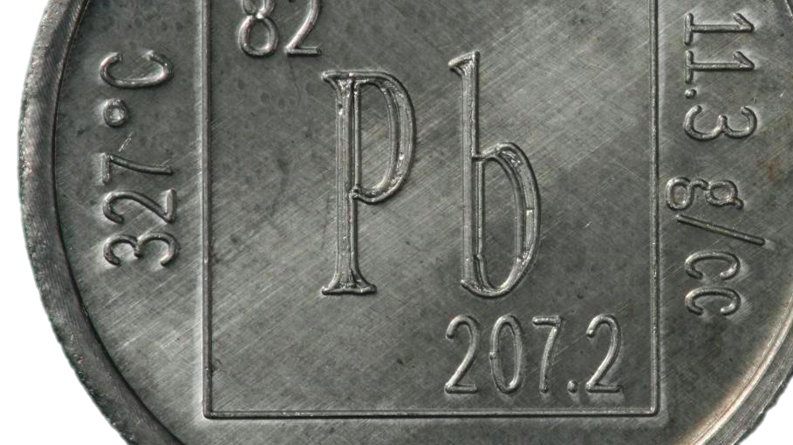
Lead-based Paint Hazards
Overview of the Lead Safe Housing Rule & Lead Disclosure Rule
Spring 2017

Slide 2
Lead Poisoning & Health
Children
No safe level for children
Adults
Memory loss, lack of concentration, irritability, depression
Decreased IQ, hearing loss, learning disabilities
Reduced bone and muscle growth
Nervous system and kidney damage
Anemia
Digestive system problems
Nervous system damage
Fatigue, joint and muscle pain
High blood pressure
Damage to kidneys and reproductive system

Slide 3
Lead Hazards in Housing
Lead Hazards
Scope of Problem
Economic Impacts
Chipping, peeling, flaking paint (pre-’78)
Household items such as pottery, toys, cosmetics, etc.
$5.9 billion in annual medical costs
$50.9 billion in lost productivity
Most common in low-income and minority communities
Water supply (leaching from pipes, solder, and fittings)
Estimated 6,700 children with elevated blood lead levels (EBLLs) in HUD-assisted housing
37 million homes with LBP, 23 million with LBP hazards
Soil contamination
Over 500,000 children with blood lead levels above CDC’s reference value
Notes:
About 4 million children under age 6 in homes with LBP hazards
Lead paint was a more durable, weather and moisture resistant paint. Homes built before 1940 are most likely to have LBP. It was most often used in trim (molding, door and window frames), kitchens, bathrooms, and exterior surfaces subject to weathering.
In multi-unit buildings, especially those built after 1960 – the lead paint will be limited to exterior and some metal surfaces (hand rails, elevator doors, etc.)

Slide 4
Lead in Housing - Regulations
Lead Disclosure Rule
24 CFR Part 35 - Subpart A
Lead Safe Housing Rule
24 CFR Part 35 – Subparts B – R
Renovation, Repair and Painting Rule
Monitored and Enforced by the EPA & some states
Applies to any renovation, repair and painting project that may disturb LBP
Requires disclosure of LBP hazards and Protect Your Family From Lead in Your Home
Subpart L – Public Housing Programs
Subpart M – Tenant-Based Rental Assistance
Subpart H – Project-Based Rental Assistance (includes PBV)
Notes:
LDR Targets both assisted and non-assisted housing pre-1978 housing at sale or lease, Jointly enforced by HUD and EPA with DOJ support
LSHR applies to federally assisted housing and is monitored and enforced by HUD
RRP applies to any renovation repair and painting projects being done by a contractor that disturb lead-based paint in homes, child care facilities and pre-schools built before 1978. Monitored and Enforced by EPA and some states

Slide 5
New Lead Safe Housing Rule
September 2016 – HUD announced proposed new LSHR
October 12, 2016 - Convening on HUD’s Proposed LSHR
January 13, 2017 – Final Rule Published
February 13, 2017 – Effective date for the new LSHR
July 13, 2017 – Compliance date – all PHA policies and procedures must comply with the new LSHR
Notes:
LDR Targets both assisted and non-assisted housing pre-1978 housing at sale or lease, Jointly enforced by HUD and EPA with DOJ support
LSHR applies to federally assisted housing and is monitored and enforced by HUD
RRP applies to any renovation repair and painting projects being done by a contractor that disturb lead-based paint in homes, child care facilities and pre-schools built before 1978. Monitored and Enforced by EPA and some states

Slide 6
Housing Choice Vouchers
Lead Disclosure Rule (Subpart A)
Owner provides “Protect Your Family” pamphlet
LBP Evaluation & Responsibilities (Subpart M)
Paint stabilization, clearance, and ongoing LBP maintenance
EBLL Response (Subpart M)
PHA reports confirmed EBLL to HUD field office and OLHCHH within 5 days
Completed lead disclosure form including all lead information and reports
Enhanced visual assessment by qualified assessor prior to HAP and at HQS inspections if child <6
Environmental Investigation within 15 days
PHA quarterly information exchange with local public health departments
If LBP identified, notification to residents and risk assessments in other assisted units with children under age 6 (within 30 days, or 90 if more than 20 units)
Lead hazard control within 30 days (90 days if more than 20 units)
Clearance before family returns
Notes:
LBP Evaluation: clearance required if more than de minimis of LBP disturbed for paint stabilization
EBLL Response: Rule requires owner to do the notification HUD. Working with OGC to revise the rule so that PHAs handle on behalf of owners. Unsure we will be able to accomplish this before July 2017, when compliance is required.
Before Family Returns: Clearance is critical. We may want to talk a bit more about this. usually family will be relocated, and return after clearance. Relocation depends on amount and scope of work - hard to keep family out of work areas if kitchen, bathroom, etc. Easiest to do temporary location.

Slide 7
Project Based Vouchers
Lead Disclosure Rule (Subpart A)
Owner provides “Protect Your Family” pamphlet
LBP Evaluation & Responsibilities (Subpart H)
EBLL Response (Subpart H)
PHA reports confirmed EBLL to HUD field office and OLHCHH within 5 days
Completed lead disclosure form including all lead information and reports
Owner conducts risk assessments for all units prior to occupancy
Environmental Investigation within 15 days
Lead hazard control within 30 days (90 days if more than 20 units)
If LBP identified, notification to residents and risk assessments in other assisted units with children under age 6 (within 30 days, or 90 if more than 20 units)
Incorporate ongoing LBP maintenance and reevaluation activities into regular operations until all LBP is removed
A visual assessment for deteriorated paint, bare soil, and the failure of any hazard reduction measures at unit turnover or every 12 months
Notes:
Pause here and see if this was well know by field. When lead regs were first completed, PIH had a lot fewer PBVs. We recognize this will be an area where we need to do more outreach, esp. to determine if pro-active risk assessments have been completed.

Slide 8
Public Housing
Lead Disclosure Rule (Subpart A)
PHA provides “Protect Your Family” pamphlet
LBP Evaluation & Responsibilities (Subpart L)
EBLL Response (Subpart L)
PHA reports to HUD field office and OLHCHH (and to public health dept. if notification from elsewhere) within 5 days of notification of confirmed EBLL
Completed lead disclosure form including all lead information and reports
LBP inspections by certified lead professional of all public housing properties
Lead hazard control within 30 days (90 days if more than 20 units)
If LBP identified, notification to residents and risk assessments in other units with children under age 6 (within 30 days, or 90 if more than 20 units)
Abatement of all identified LBP (required on modernization)
Risk assessment and interim controls until abatement completed
Ongoing maintenance if lead paint not removed – risk assessments & interim controls until abated
Environmental Investigation within 15 days
Notes:
The ‘99 regs allow for PHAs to delay paint abatement until modernization. At this point, if not already completed – they should just get it done. The cost of doing annual risk assessments and interim controls can be significant.

Slide 9
Environmental Investigation
Conducted within 15 days of notification of a child under age 6 with an EBLL (PHA)
Includes the components of a Risk Assessment with addition of a questionnaire
Questionnaire is to better identify the source of lead contamination
  Dwelling unit,
  Previous dwelling unit,
  Day care
  Foods or medicines
  Cosmetics
  Pottery or other household items

Slide 10
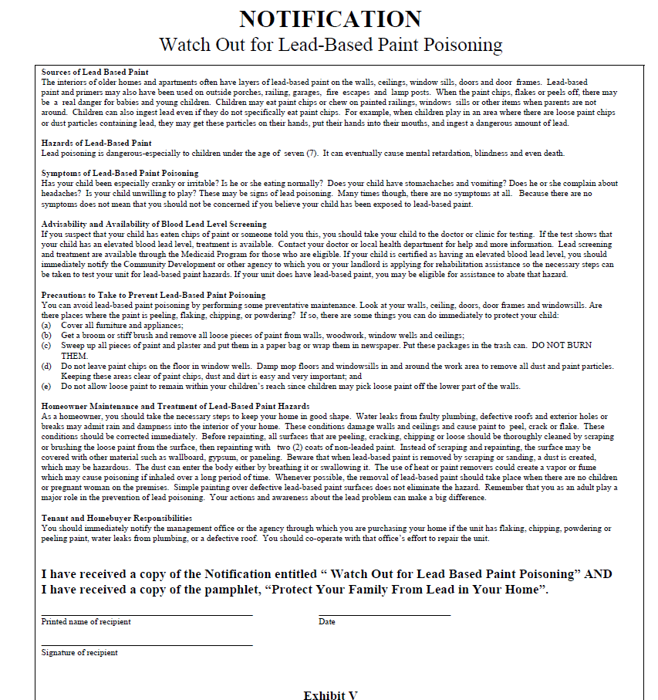
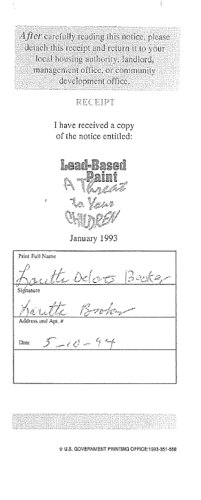

Lead Disclosure Rule
The WRONG Disclosure
Notes:
May 2016 – OFO begins contacting PHAs regarding documentation deficiencies
September 2016 – HUD announced proposed new Lead Safe Housing Rule
October 12, 2016 - Convening on HUD’s Proposed Lead Safe Housing Rule
Proposed Rule - Lowers threshold of lead measured in a young child’s blood to match the CDCs (from 20 micrograms to 5, with future adjustments)

Slide 11
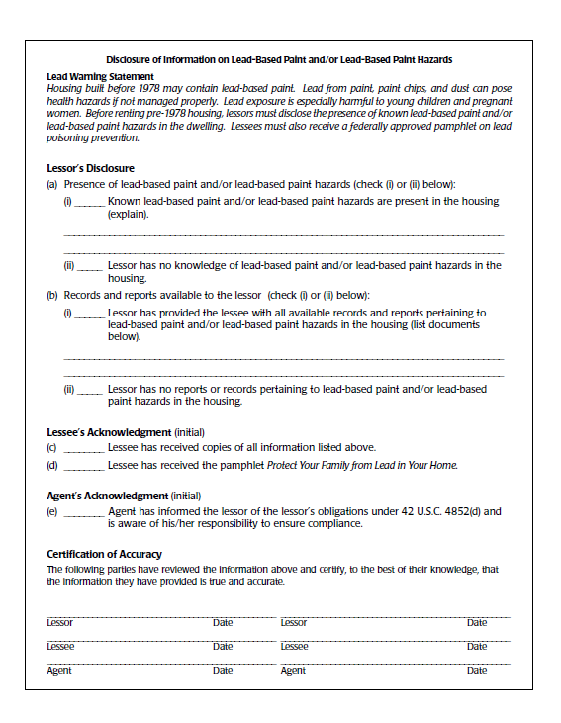
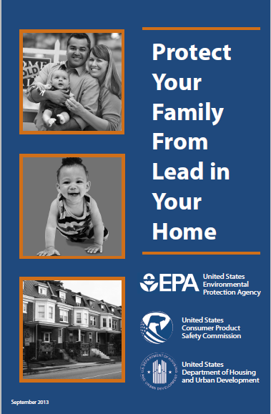
Lead Disclosure Rule
The Correct Disclosure
Notes:
May 2016 – OFO begins contacting PHAs regarding documentation deficiencies
September 2016 – HUD announced proposed new Lead Safe Housing Rule
October 12, 2016 - Convening on HUD’s Proposed Lead Safe Housing Rule
Proposed Rule - Lowers threshold of lead measured in a young child’s blood to match the CDCs (from 20 micrograms to 5, with future adjustments)

Slide 12
Lead Safe Work Practices
Certified LBP inspector or risk assessor determines whether LBP is present to determine if EPA’s Renovation Repair and Painting rule applies
Lead-safe work practices must be followed during the job
Clearance examination by an independent party when work is completed
Notification to occupants within 15 days after lead hazard evaluation and control activities (see 24 CFR 35.125 for more information)

Slide 13
Elevated Blood Lead Level
Prior LSHR required action based on an Environmental Intervention Blood Lead Level (EIBLL, or “eye-bull”)
  >= 20 micrograms/deciliter of blood in one draw
  >= 15 micrograms/deciliter over two tests at least three months apart
New LSHR threshold for action
  Confirmed EBLL >= 5 µg/dL (micrograms/deciliter)
    Notification by public health department or other medical health care provider
    If reported by family or other source, PHA should attempt to confirm
  Aligned with Centers for Disease Control and Prevention (CDC) reference range of 5 µg/dL (to be updated by HUD via Notice)
  Eliminates reference to EIBLL (replaced with EBLL)
Responses aligned for public housing and HCV programs

Slide 14
Exemptions
24 CFR 35.115
Property constructed after January 1, 1978
Zero-bedroom units and SROs
Housing for the elderly, or a residential property designated exclusively for persons with disabilities
  Does not apply if a child less than age 6 resides or is expected to reside in the dwelling unit
  Definitions of “housing for the elderly” and “expected to reside” in §35.110
Properties found to be lead-free by a LBP inspection
Properties where all LBP has been identified, removed, and clearance achieved (except where enclosure or encapsulation used)
An unoccupied property that is to be demolished provided that it remains unoccupied until demolition
Notes:
There are several other exemptions, including those related to emergency actions and historic preservation.
Talk here about the QHWRA designation/grand-fathering. Must be both elderly and disabled (mixed) and in continuous operation as such, but these questions should be referred to the local PIH field office for clarification as cases are often unique.
Also, point out that if an EBLL occurs in a designated property, that’s most likely the evidence that the child has been residing there, and the unit is now subject to the EBLL requirements.

Slide 15
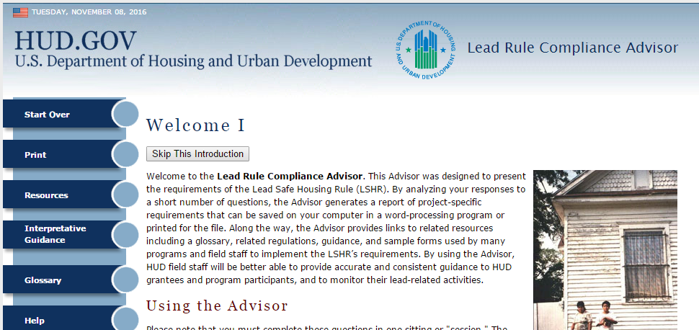
Lead Disclosure Rule & Lead Safe Housing Rule
Lead Rule Compliance Advisor

Slide 16
Preparing for full compliance for PHAs that manage public housing
Take steps now to ensure your PHA is able to quickly respond to EBLL notification.
Verify that all lead-based paint testing is complete and documentation is available.
Ensure that all PHA employees that disturb paint in pre-1978 housing are certified under EPA’s Renovation, Repair, and Painting rule.
Identify a contact person at the local or state health department for communication and data sharing.
Inform residents of the risks of lead-based paint and encourage them to have young children tested for lead in their blood.

Slide 17
Preparing for full compliance for PHAs that manage an HCV program
Ensure that HQS inspectors have completed visual assessment training for deteriorated paint and conducting them for units where a family with a child under age six lives.
Determining whether lead evaluations will be performed by trained, certified PHA staff or through the use of a contract.
Identify a contact person at the local or state health department for communication and data sharing.
Inform residents of the risks of lead-based paint and encourage them to have young children tested for lead in their blood.
Engage HCV landlords about lead safety and their obligations under the LSHR, including the Lead Disclosure Rule.
For project-based vouchers (PBVs), ensure that all units have already received a risk assessment and hazard control as outlined in Subpart H of the LSHR

Slide 18
Lead-Based Paint Resources
HUD Guidelines for the Evaluation and Control of Lead-Based Paint Hazards in Housing, Office of Healthy Homes and Lead Hazard Control, Second Edition, July 2012
Notice PIH 2017-13; Guidance on HUD’s Lead Safe Housing Rule Pertaining to Elevated Blood Lead Levels for the Public Housing, Housing Choice Voucher, and Project-Based Voucher Programs

Slide 19
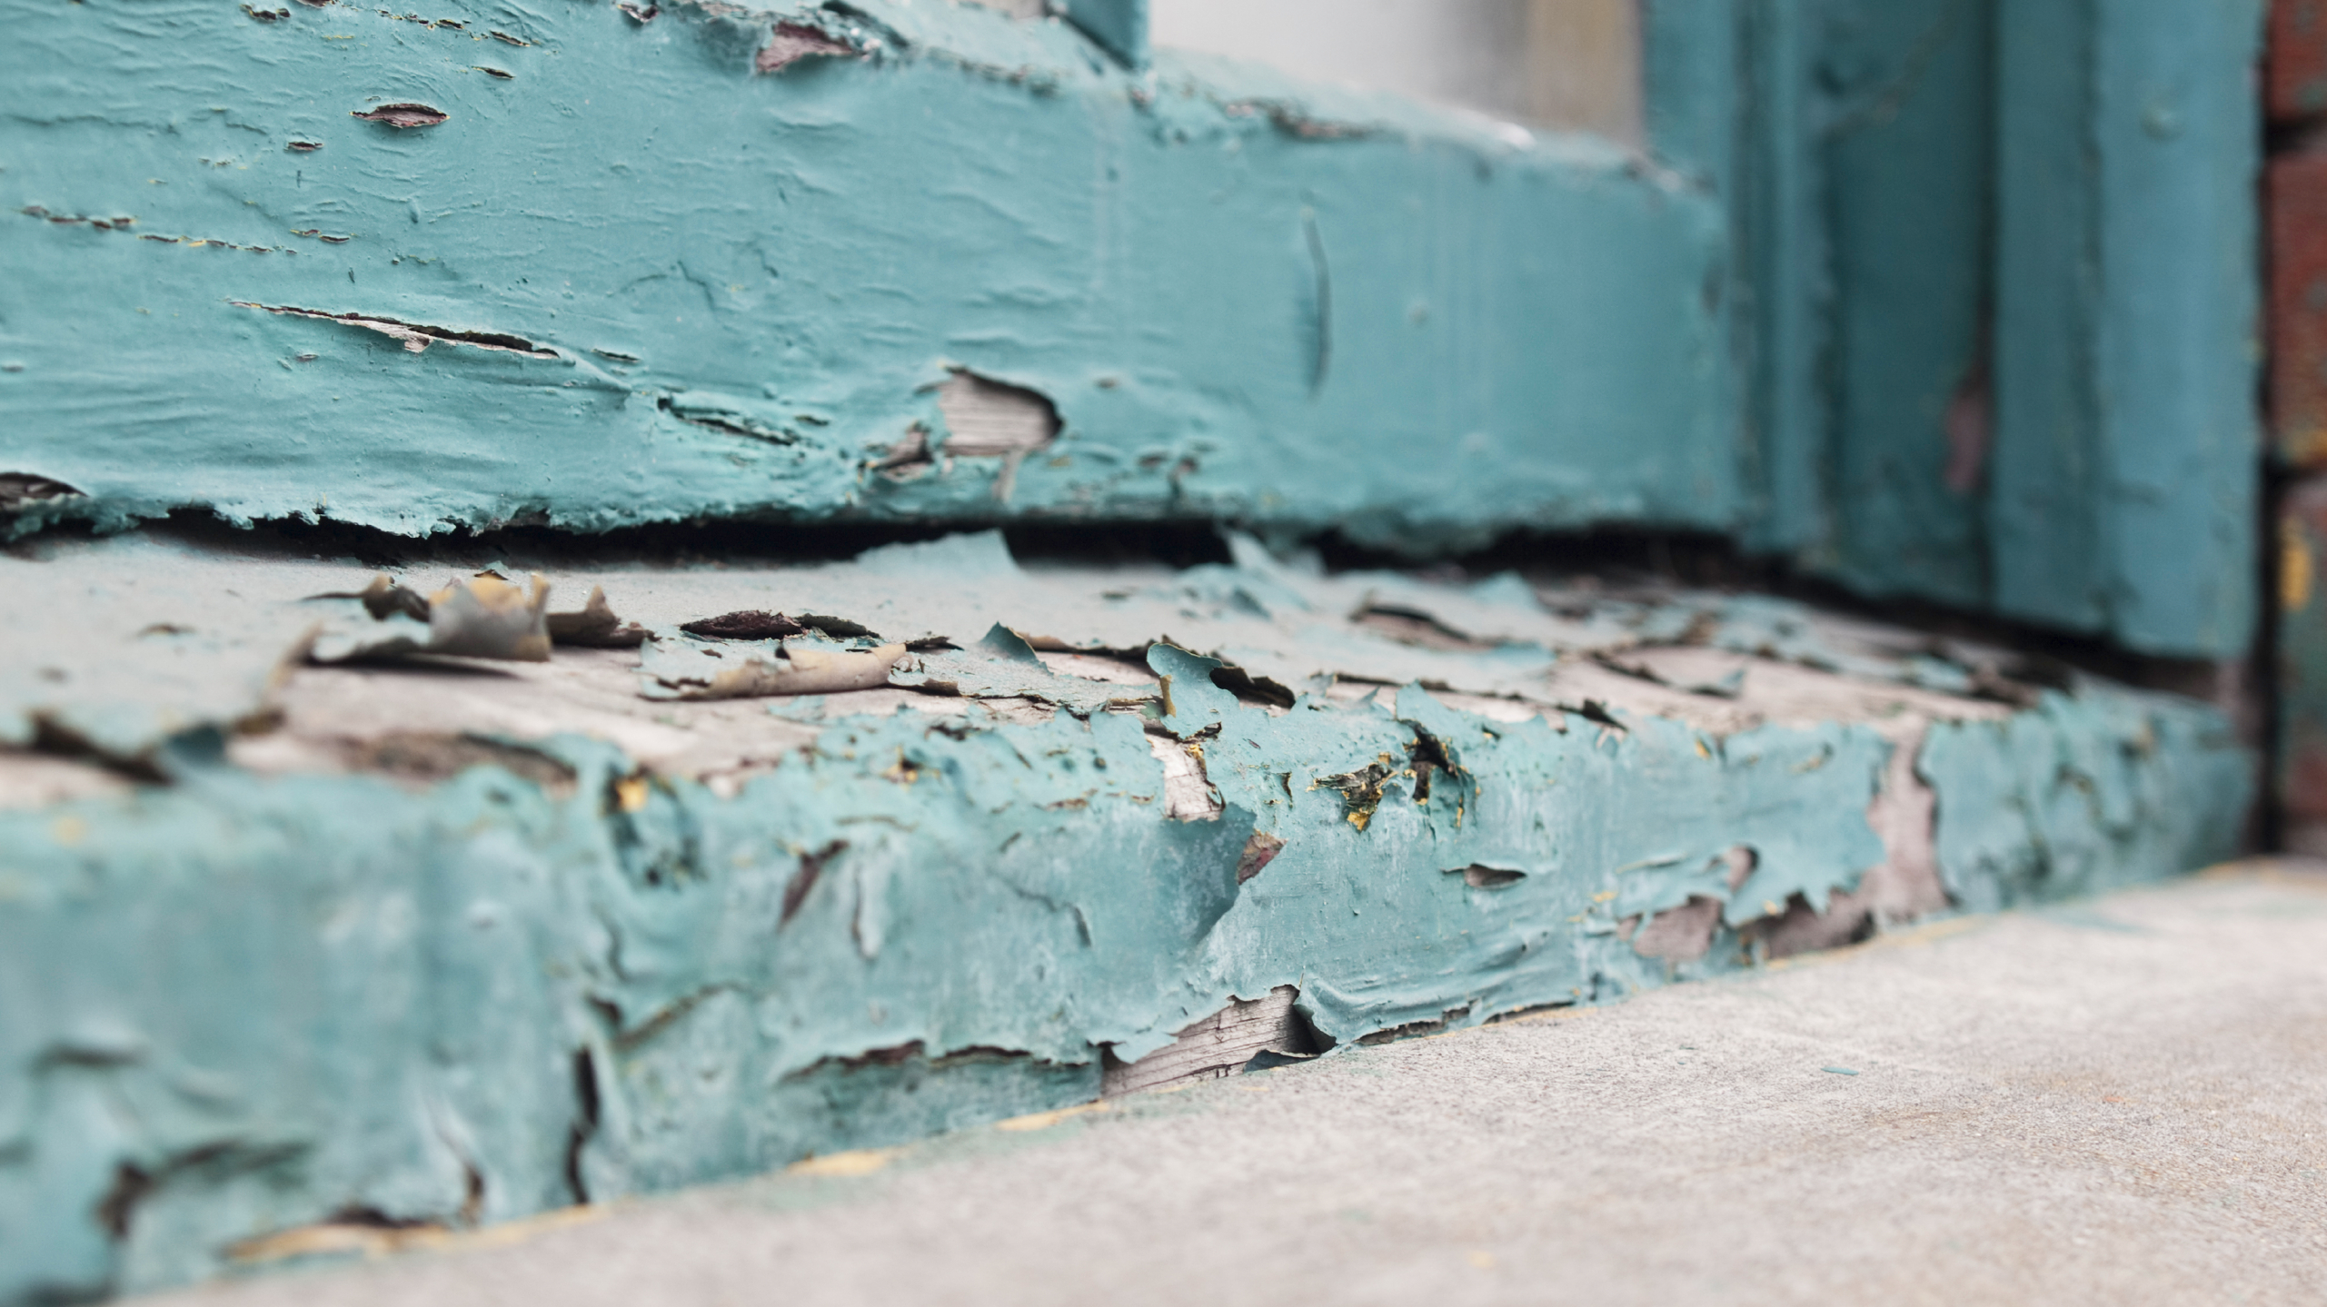
Questions
Notes:
If a PHA notifies you that they have a confirmed EBLL>5, advise them to comply with the regulation because it is effective. (Tampa case)

